Slide 1
J58 (JT11D-20)
Aponte, Edwin; Lagares, Christian; Quijano, Joel
Department of Mechanical Engineering
INME 4707-030
University of Puerto Rico at Mayaguez

Slide 2
J58 (JT11D-20) – Project Summary
INSERT SUMMARY

Slide 3
J58 (JT11D-20) – Introduction
INSERT PROBLEM STATEMENT

Slide 4
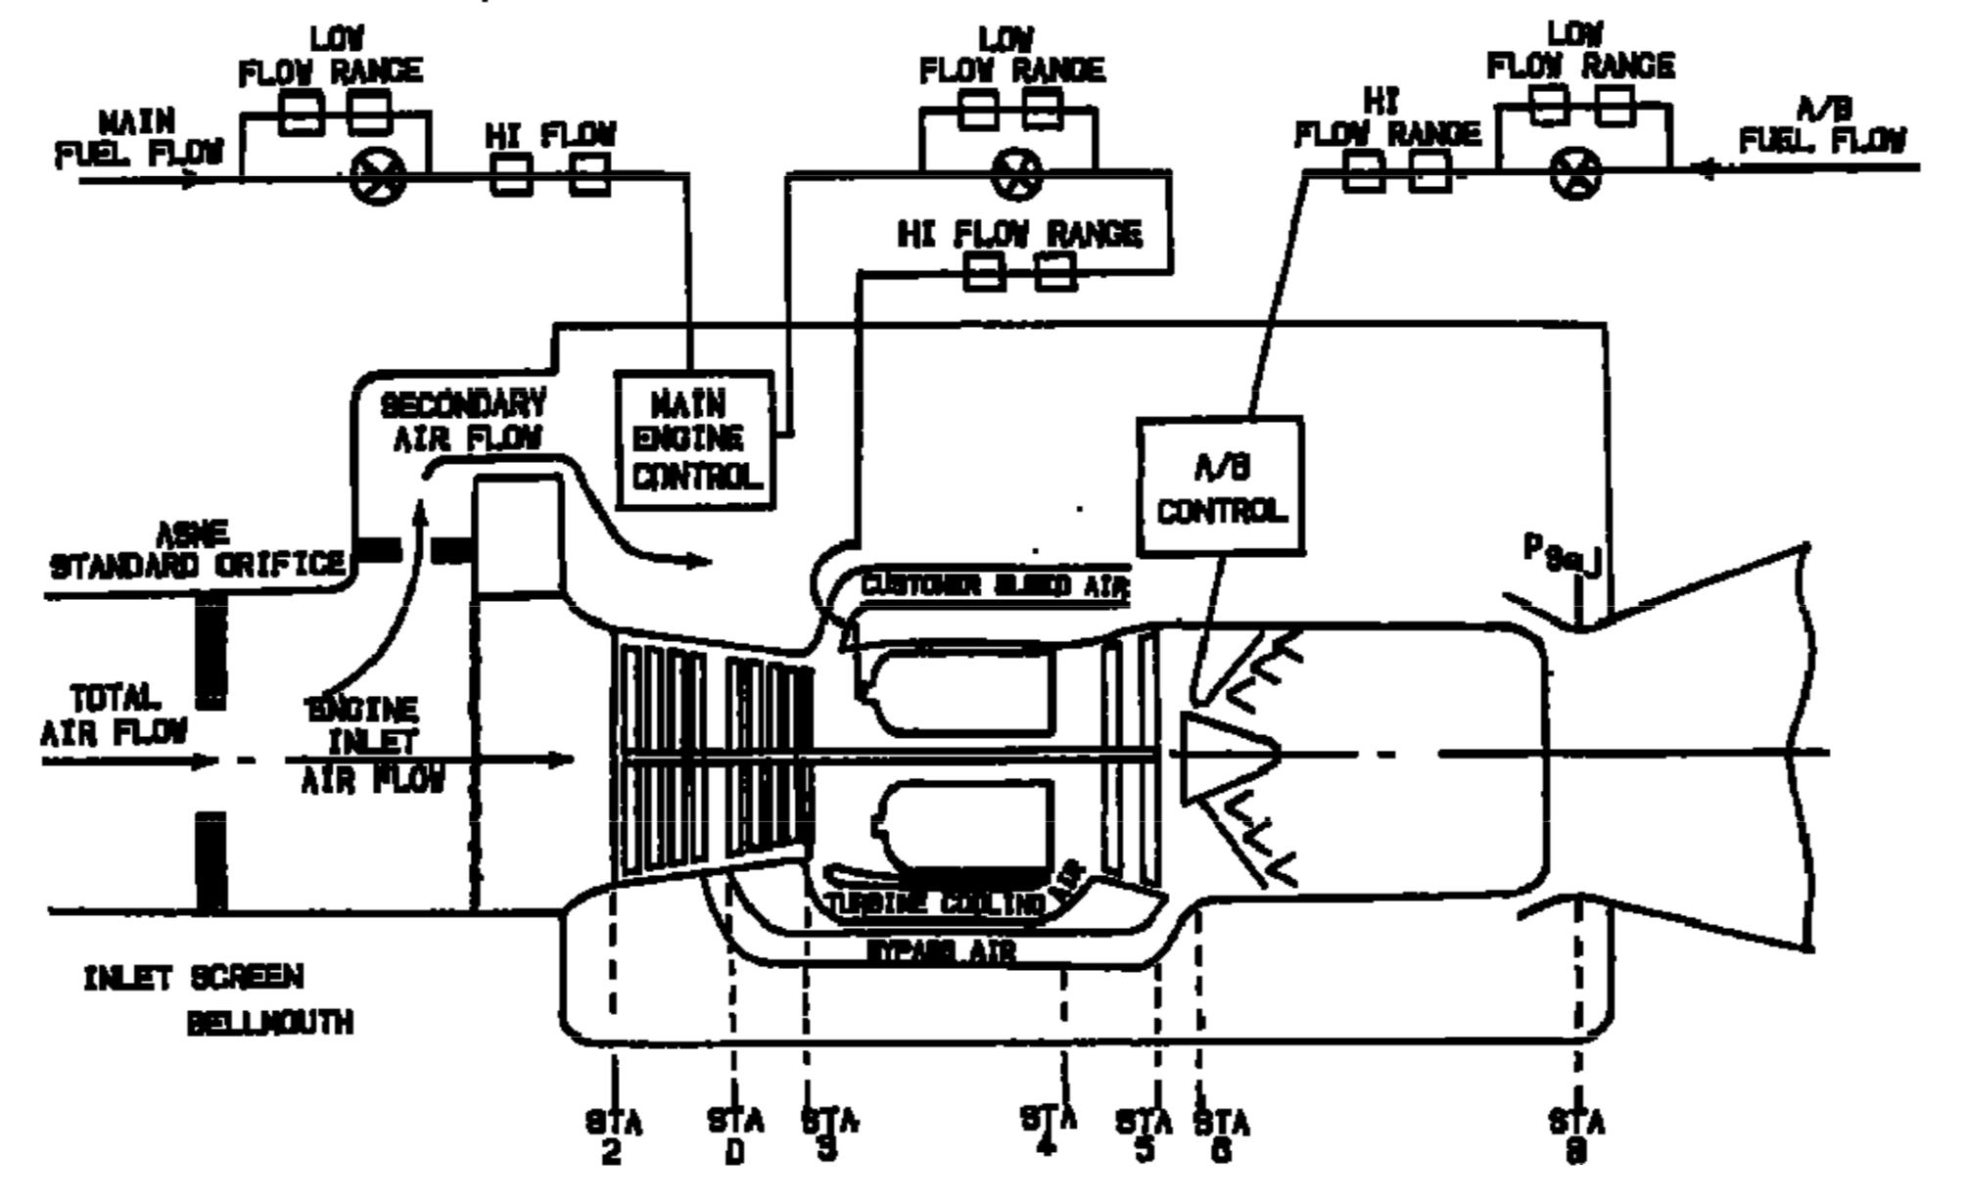
J58 (JT11D-20) – Introduction
Figure 1: Standard J11D-20 Station Nomenclature [1]

Slide 5
J58 (JT11D-20) – Introduction
Table 1: Maximum Operating Temperatures [1] [2]
COMPONENT/STAGE | TEMP (ºF) | TEMP (ºC)
Inlet T1 | 800+ | 426+
COMPRESSOR Inlet T2 | 800+ | 426+
COMPRESSOR 4th Stage TD | 1050 | 565.56
COMBUSTOR Inlet T3 | 1300 | 704.44
TURBINE Inlet T4 | 2000 | 1093.33
TURBINE Exit T5 | 1450 | 787.78
AB T6 | 3200 | 1760
Exhaust NOZZLE T8 | 1500 | 815.15

Slide 6
J58 (JT11D-20) – Introduction
Table 2: Engine Specs
SPECIFICATION | VALUE RANGE [EN] | VALUE RANGE [SI]
Altitude [4] | 25K-90K ft | 7.62 – 27.43 km
Speed [5] | Mach 0.75 – 3.2
Dry TSFC @ Max Thrust [6] | 0.8 lb/lbf hr | 81.6 kg/kN hr
Wet TSFC @ Max Thrust [6] | 1.9 lb/lbf hr | 164 kg/kN hr
Fuel [7] | JP-7
Fuel Storage [8] | 80,285 lb | 36,416 kg
Fuel Lower Heating Value [9] | 5.48 kWh/lb | 43,682 kJ/kg
Thrust [7] | 32,500 lbf | 144,567 N
Air Volume Flow @ Cruise [10] | 100K ft³/s | 2831.68 m³/s

Slide 7
J58 (JT11D-20) – Introduction
Table 2: Engine Specs (Cont.)
SPECIFICATION | VALUE RANGE [EN] | VALUE RANGE [SI]
Compression Ratio < Mach 2.2 [8] | 8.8:1
Compressor [11] | 8-Stage Axial
Turbine [11] | 2-Stage
Weight [11] | 6,500 lb | 2,948 kg
Air Mass Flow [8] | 326-450 lb/s | 147 – 204 kg/s
Dry Fuel Mass Flow @ Max | 5.55 lb/s | 2.52 kg/s
Wet Fuel Mass Flow @ Max | 17.94 lb/s | 8.14 kg/s
Dry Fuel to Air Ratio | 0.012-0.017
Wet Fuel to Air Ratio | 0.0398-0.055

Slide 8
J58 (JT11D-20) – Introduction
Table 3: Validation Flight Conditions
Condition ID | Altitude [ft] | Mach | Afterburner
Takeoff [2] | 0 (@ Sea level) | 0.3542 | ON
Refueling/Buddy Mission [2] | 25000 | 0.75 | OFF
Climbing [2] | 30000 | 1.25 | ON
Concorde [12] | 60000 | 2.00 | ON
YF12A (03/18/65) | 65000 | 2.2 | ON
A12 Max Altitude at Mach 2.2 | 75000 | 2.2 | ON
Lake County Airport | 9928 | 0.3545 | ON
Lowest Altitude at Mach 1.0 | 15000 | 1.0 | ON
9
10
11
12

Slide 9
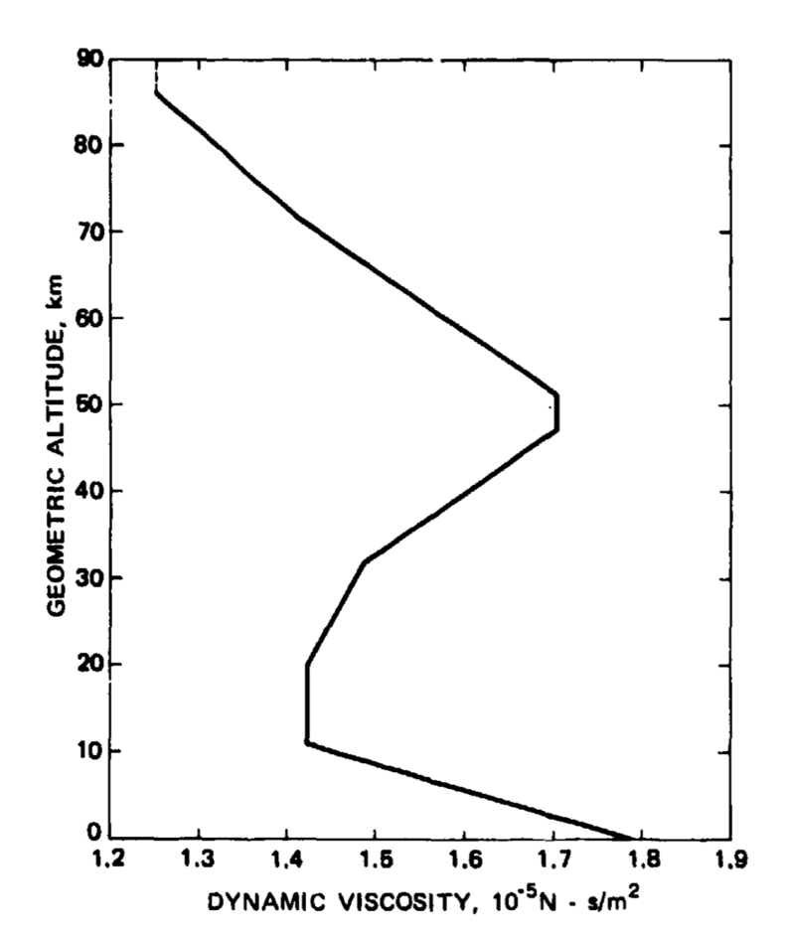
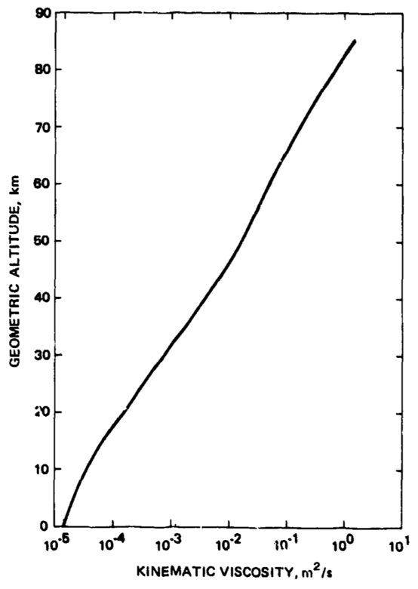
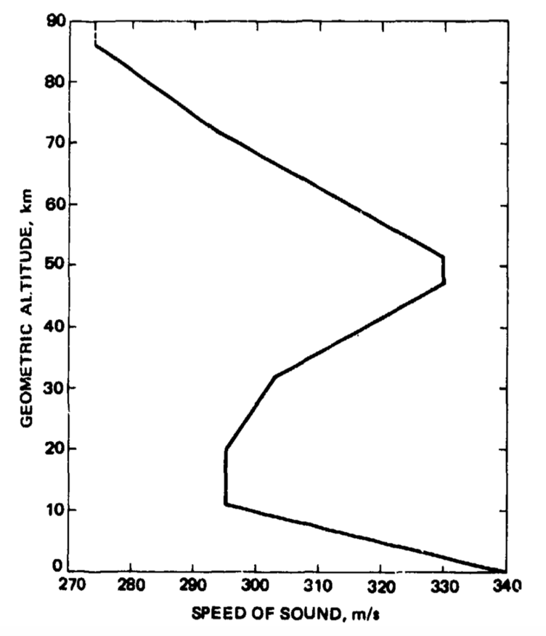
J58 (JT11D-20) – Standard Atmosphere
Figure 2-4: Standard Atmosphere Dynamic Viscosity, Kinematic Viscosity and Speed of Sound [15]

Slide 10
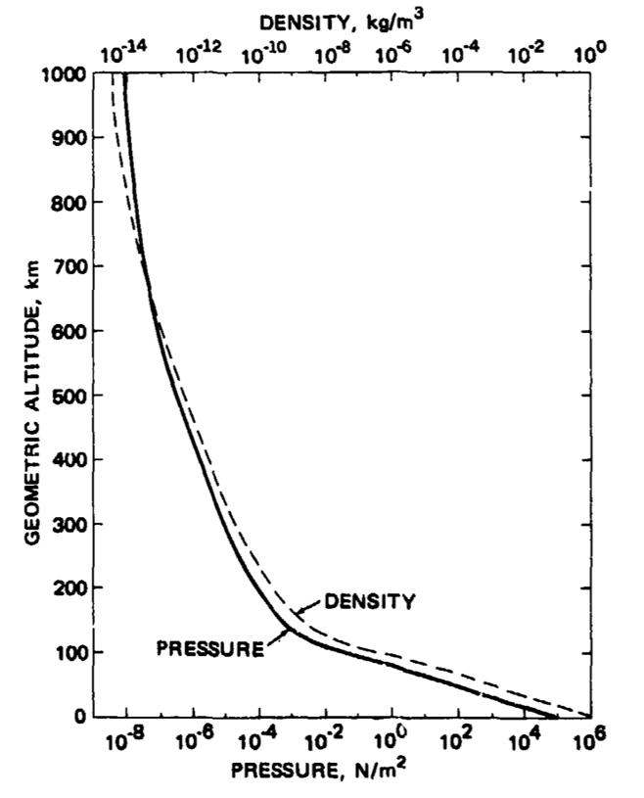
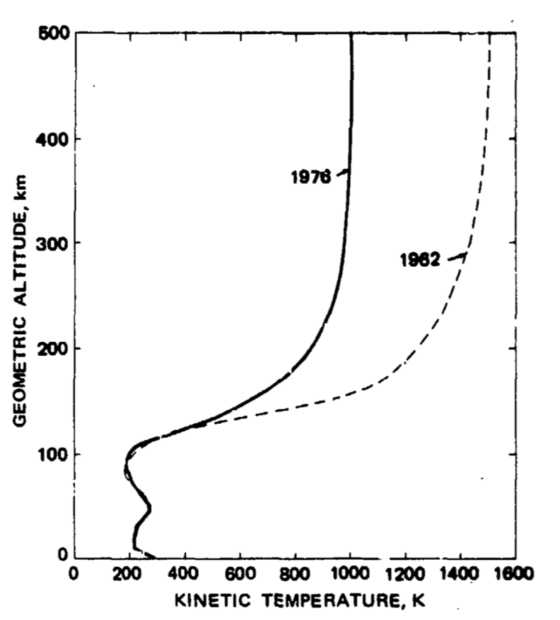
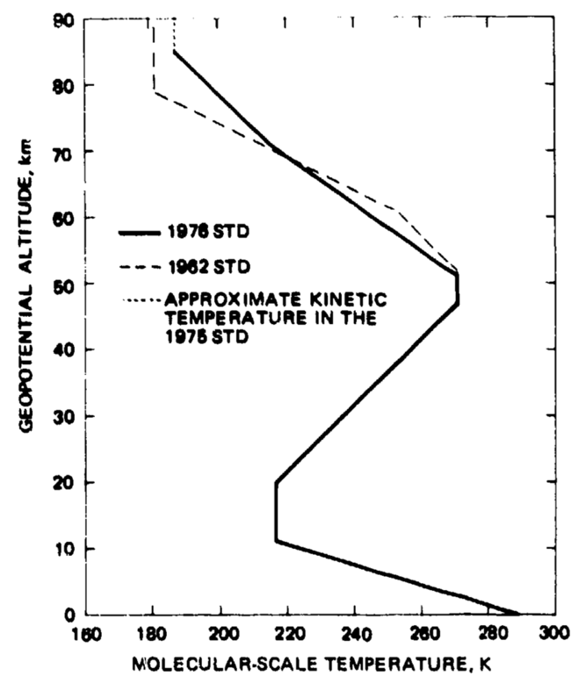
J58 (JT11D-20) – Standard Atmosphere
Figure 5-7: Standard Atmosphere Pressure, Kinetic Temperature and Molecular-Scale Temperature [15]

Slide 11
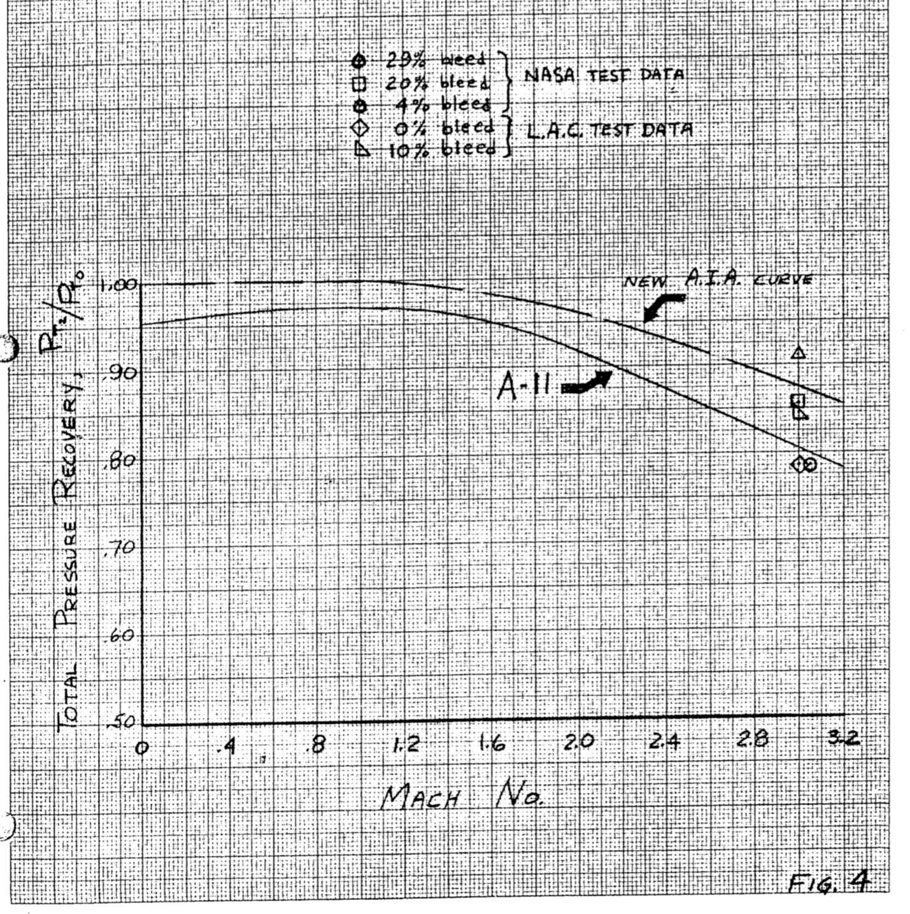
J58 (JT11D-20) – Inlet
Figure 8: Expected Inlet Performance [16]

Slide 12
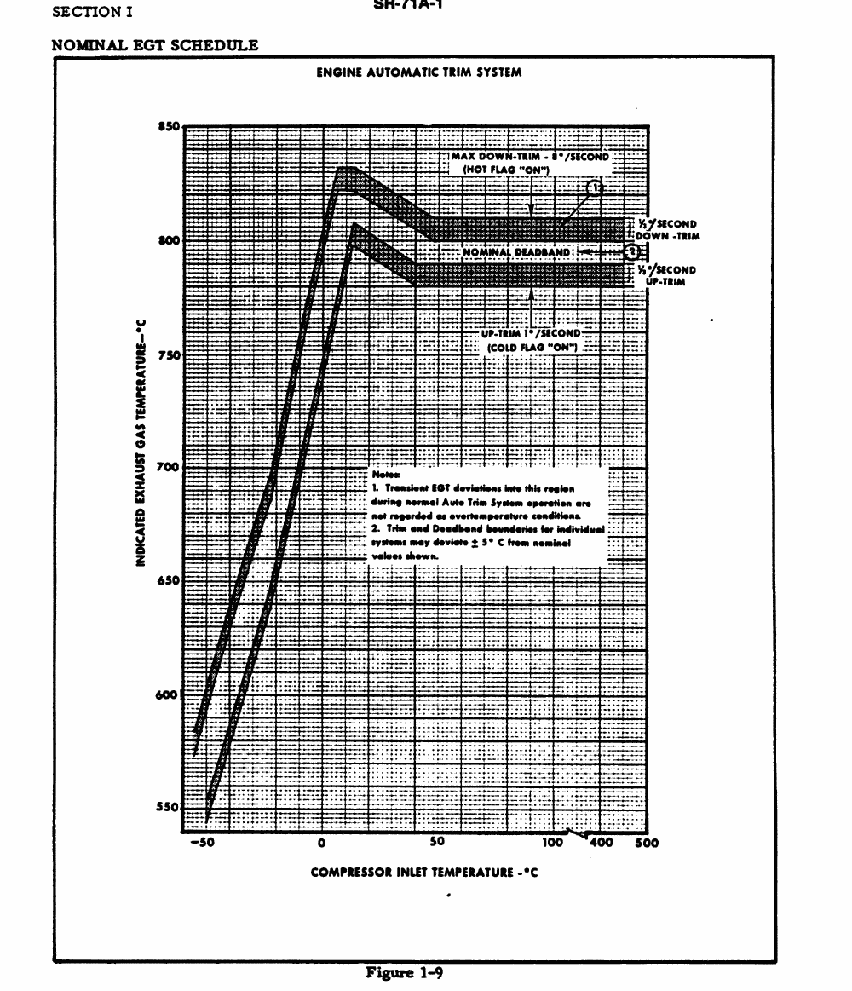
J58 (JT11D-20) – EGT
Figure 9: Indicated EGT vs Compressor Inlet Temperature [2]

Slide 13


